Slide 1
Scientific Machine Learning (SciML) 101
Ján Drgoňa
SciML team: Madelyn Shapiro, Colby Ham, Jonathan Tu, Draguna Vrabie, Court Corley

Slide 2
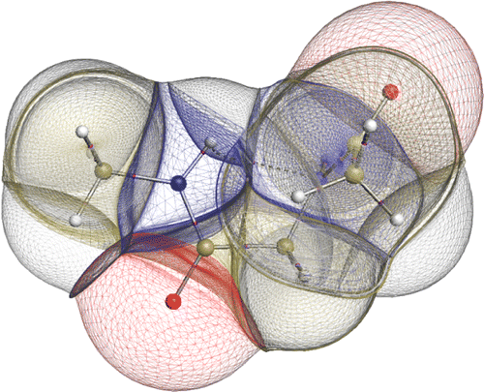

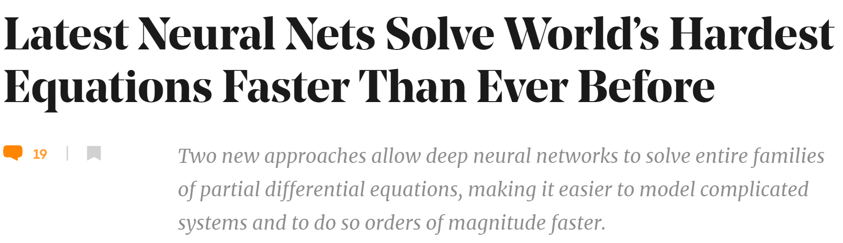

Challenges of Dynamical Systems Modeling and Control
Simulations are crucial for many areas of decision-making and scientific discovery
Need: Improve computational efficiency and scalability for heterogenous scientific simulations
Challenges:
Physically-consistent data-driven modeling
Fast simulation of complex systems
Optimal control and design of complex systems
Emerging solution:
Scientific Machine Learning connecting physics and AI

Slide 3
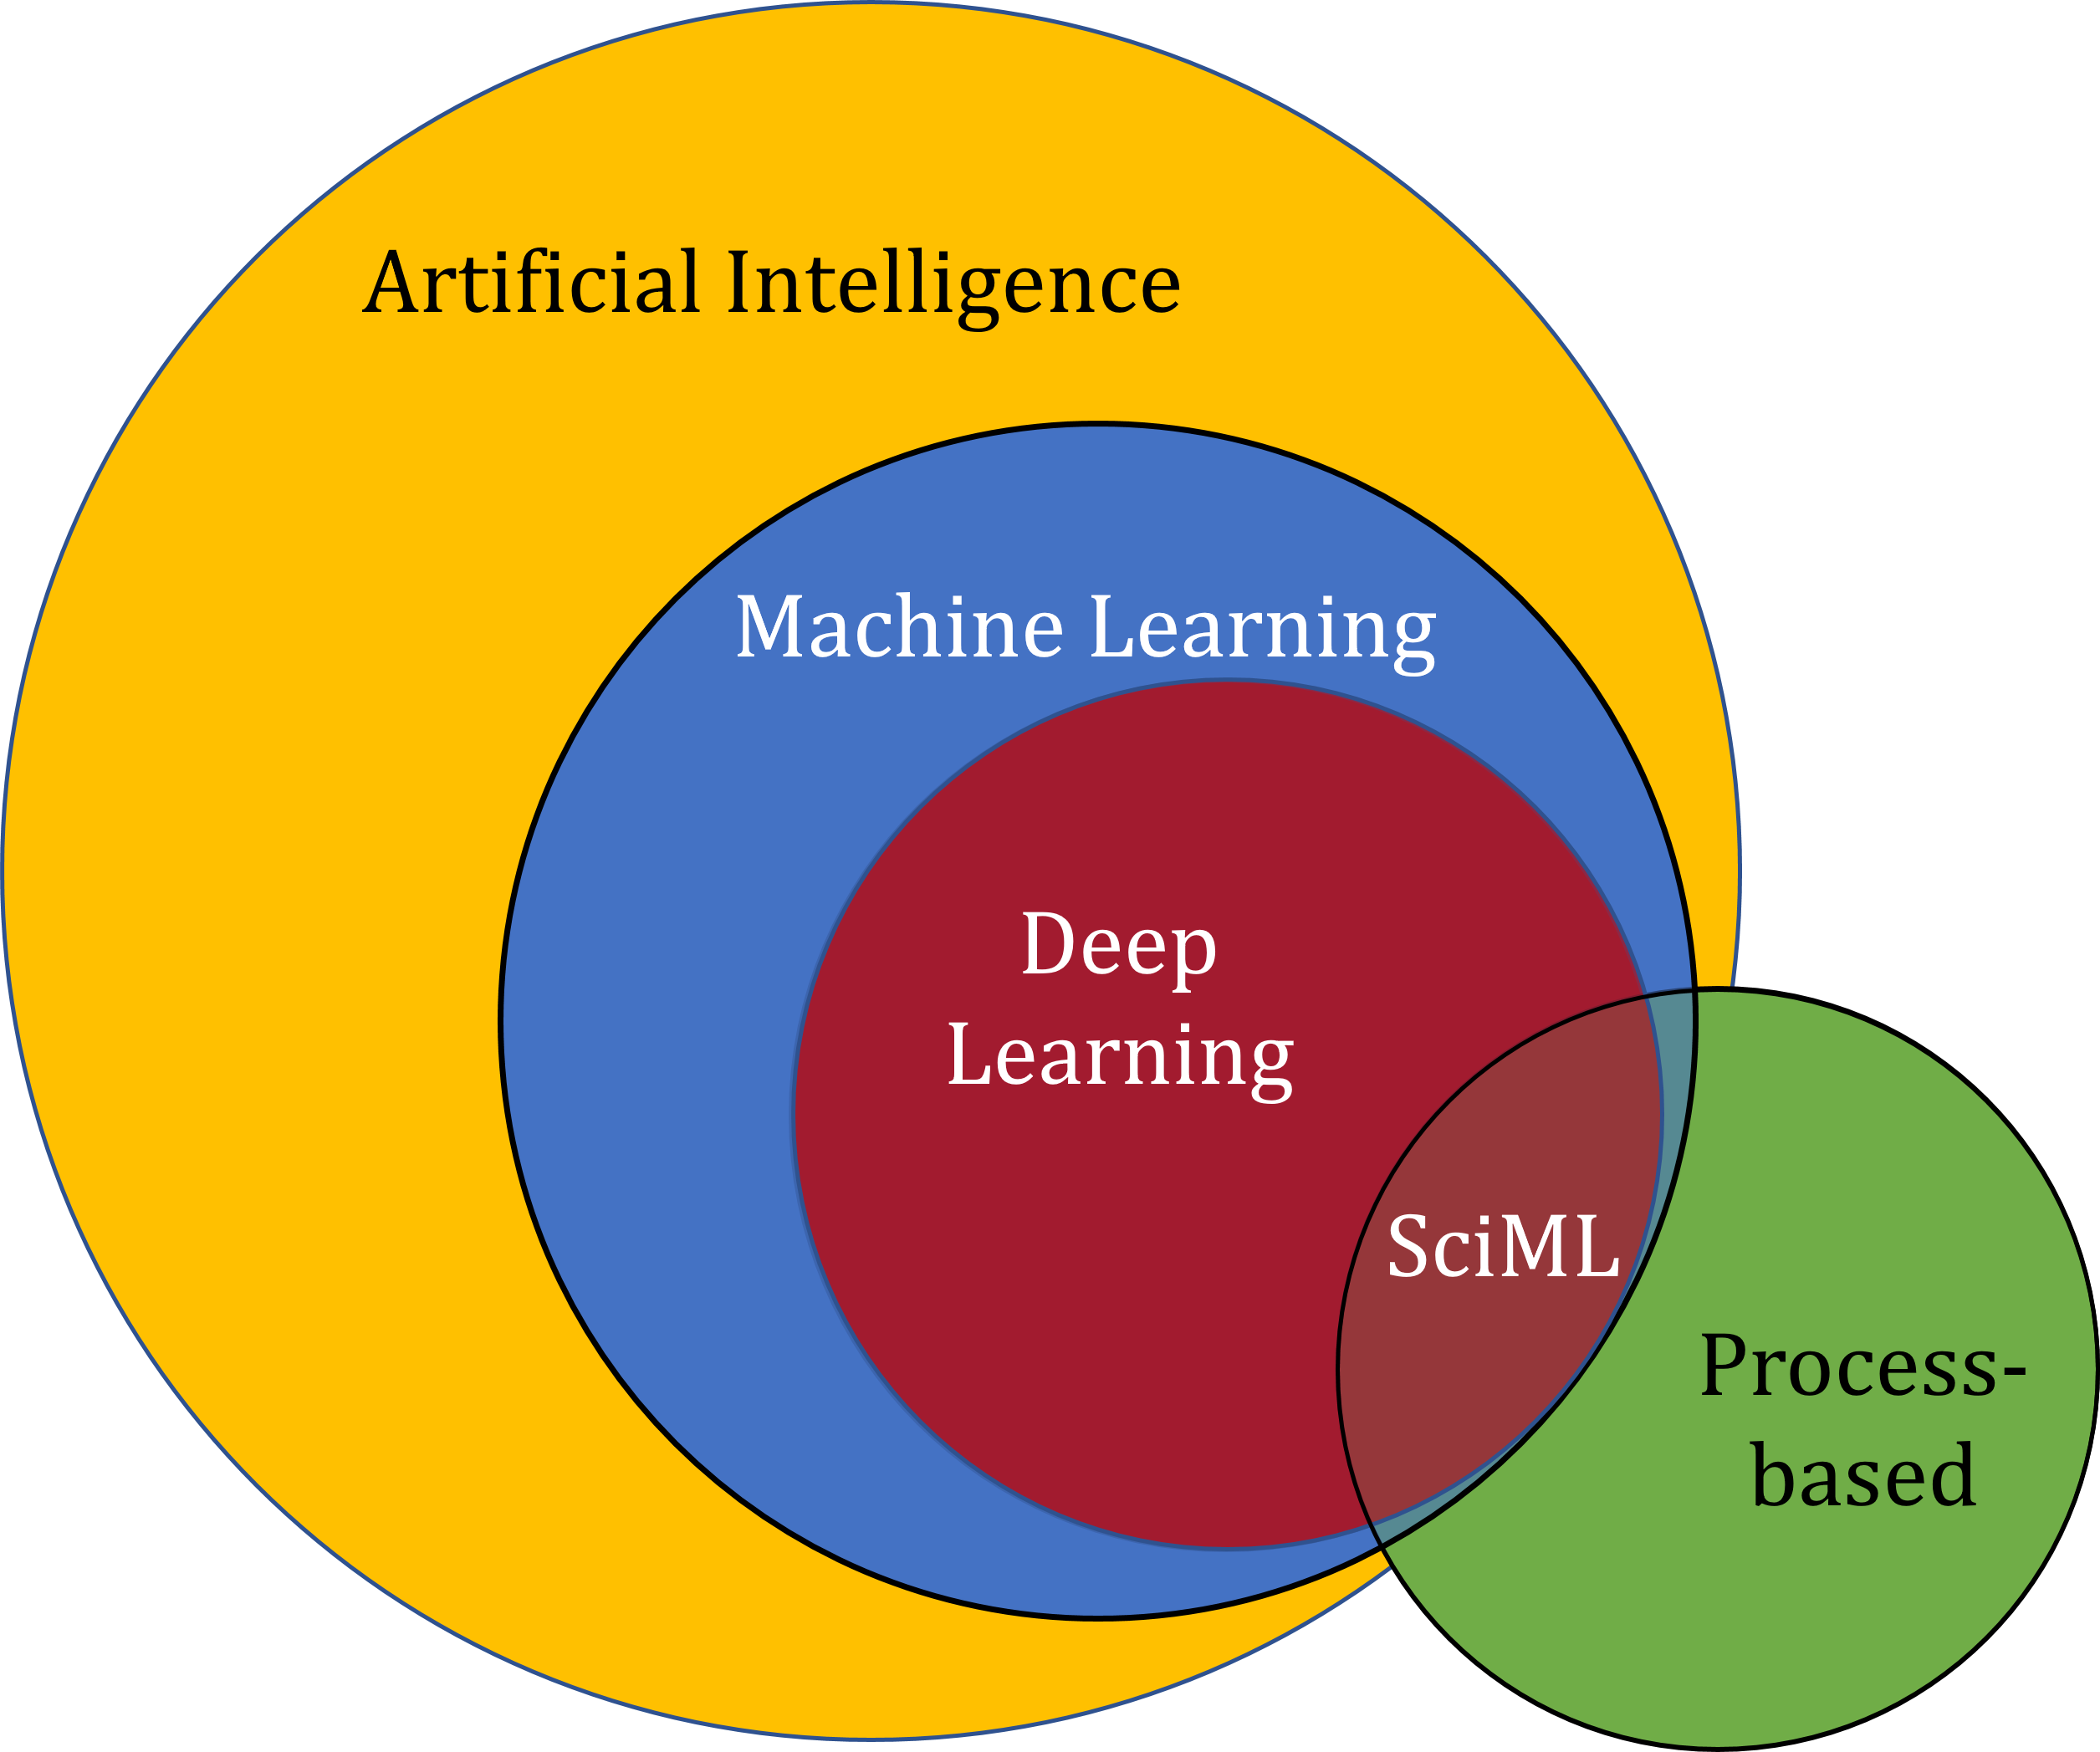
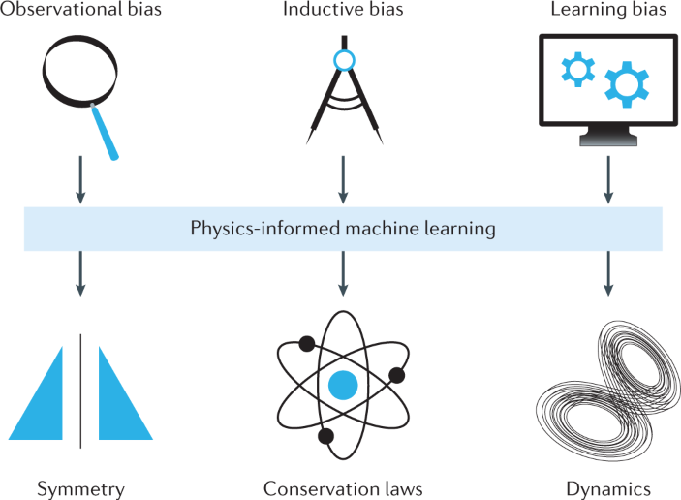
ML vs SciML
Traditional engineering applications are governed by fundamental principles and have physical constraints, invariants, and constants:
Conservation law,
Laws of motion
Physical constants (gravity)
Purely data-driven, also called black-box machine learning (ML) methods, cannot satisfy underlying physics.
Scientific Machine Learning (SciML) is a set of methods that systematically integrate ML algorithms with mathematical models and algorithms developed in various scientific and engineering domains.
[1] https://sciml.wur.nl/reviews/sciml/sciml.html
[2] Karniadakis, G.E., Kevrekidis, I.G., Lu, L. et al. Physics-informed machine learning. Nat Rev Phys 3, 422–440, 2021.

Slide 4
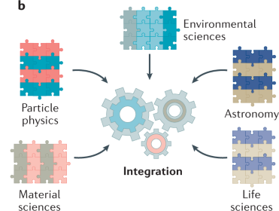
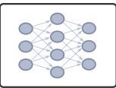
Scientific Machine Learning (SciML) Means Integrating Physics Into ML …
Benefits
Reduced data requirements for ML
Higher precision & improved generalization
Increased interpretability & trust
Safety and performance guarantees
SciML is also called:
Physics-Informed machine learning
Physics-constrained machine learning
Domain-aware machine learning
Knowledge-based machine learning
[3] Thiyagalingam, J., Shankar, M., Fox, G. et al. Scientific machine learning benchmarks. Nature Reviews Physics 4, 413–420, 2022.
[4] Nghiem T. Drgona J., et al. Physics-Informed Machine Learning for Modeling and Control of Dynamical Systems, American Control Conference (ACC), 2023.

Slide 5
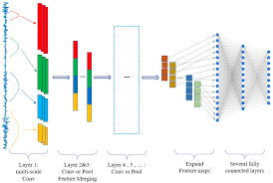
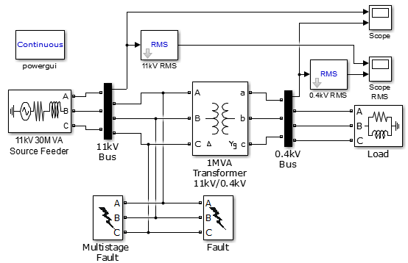
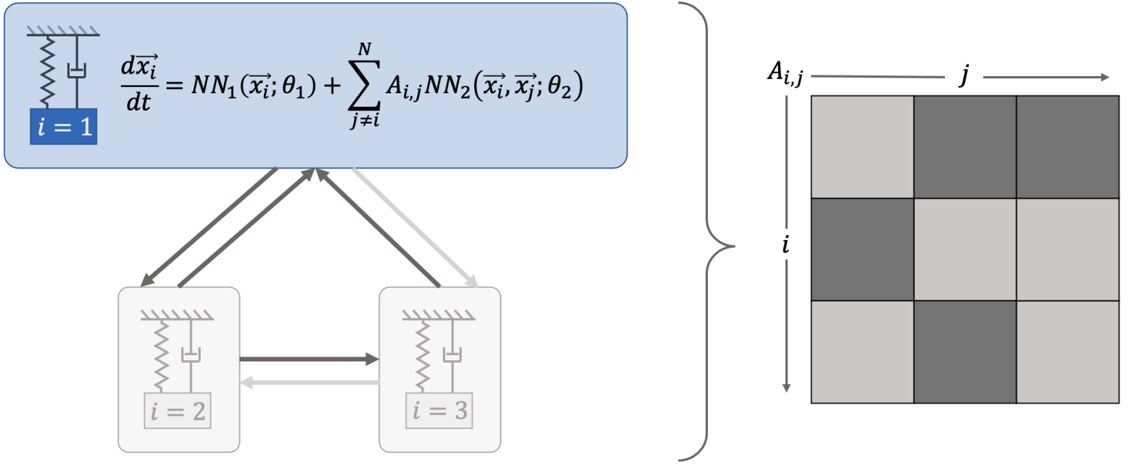

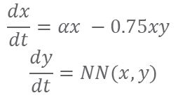
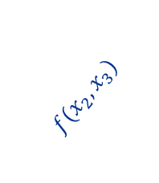
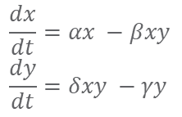
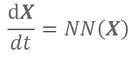
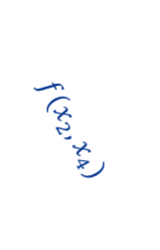
Landscape of Modeling Methods
White-box
Gray-box
Black Box
$$\frac{dx}{dt}=αx −βxy$$
$$\frac{dy}{dt}=δxy −γy$$
$$\frac{dx}{dt}=αx −0.75xy$$
$$\frac{dy}{dt}=NN(x,y)$$
$$\frac{dX}{dt}=NN\left(X\right)$$
More domain knowledge
Less domain knowledge
physics-based
networked neural ODEs
neural differential equations
state space models
physics priors
graph neural networks
3
$$f(x_{2},x_{3})$$
$$f(x_{2},x_{1})$$
1
2
$$f(x_{2},x_{4})$$
4

Slide 6

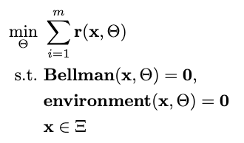

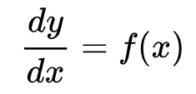

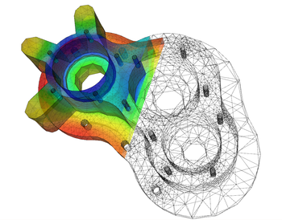
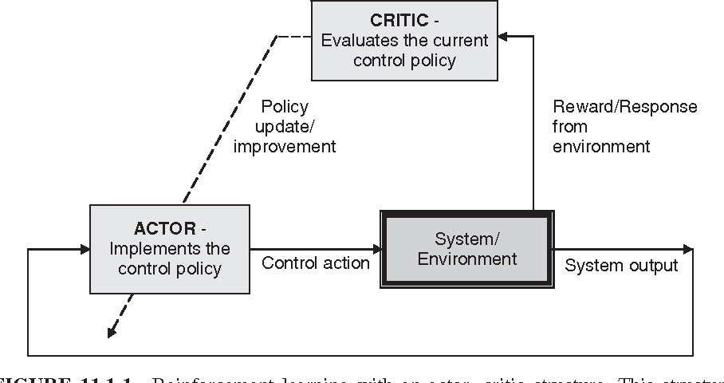

Landscape of Solution Methods
Constrained optimization
Differential equations
Supervised Learning
Reinforcement Learning
Requires prior knowledge of objective function and constraints
Requires prior knowledge of the physics to be modeled
Requires large labeled datasets
Requires environment model to sample
More domain knowledge
Less domain knowledge

Slide 7
















Landscape of Solution Tools
Constrained optimization
Differential Equations
Supervised Learning
Reinforcement Learning
More domain knowledge
Less domain knowledge

Slide 8
Landscape of SciML Methods
Physics-informed loss functions
Learning bias, regularizations, or soft constraints
Physics-informed architecture design
Inductive biases or structural priors
Physics-informed initialization
Observational biases and factorizations
Hybrid physics-ML models
Combination of ML and physics-based model
Physics-informed digital twins
[1] https://sciml.wur.nl/reviews/sciml/sciml.html
[2] Karniadakis, G.E., Kevrekidis, I.G., Lu, L. et al. Physics-informed machine learning. Nat Rev Phys 3, 2021.
[3] Thiyagalingam, J., Shankar, M., Fox, G. et al. Scientific machine learning benchmarks. Nature Reviews Physics 4, 413–420, 2022.
[4] Nghiem T. Drgona J., et al. Physics-Informed Machine Learning for Modeling and Control of Dynamical Systems, ACC, 2023.

Slide 9
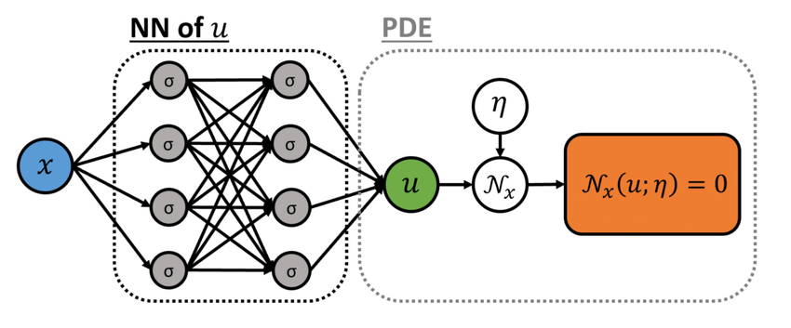
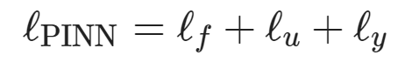
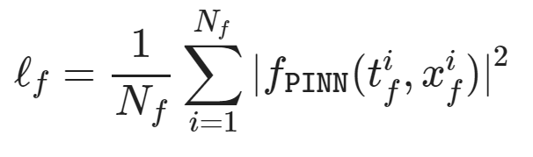
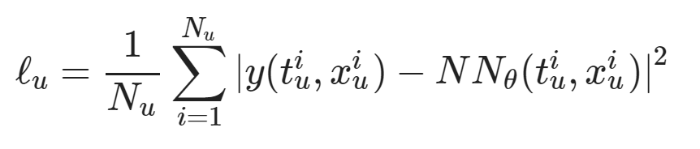
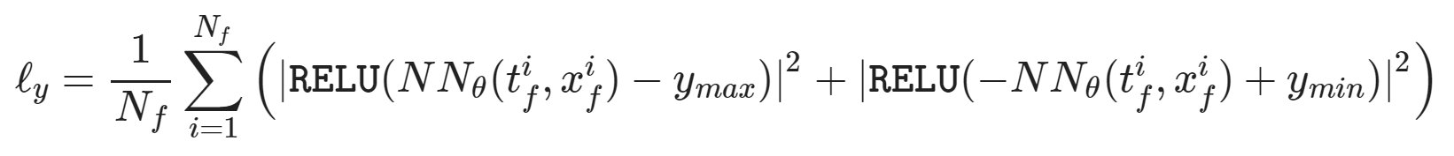
Physics-Informed Loss Functions
PIML loss
Dataset: collocation points in the input space or labeled set of inputs and outputs.
PIML Loss:
Loss Terms:
Physics residual
Initial and boundary conditions
Constraints penalties
https://github.com/pnnl/neuromancer/blob/master/examples/PDEs/Part_2_PINN_BurgersEquation.ipynb
[5] M. Raissi, et al., Physics-informed neural networks: A deep learning framework for solving forward and inverse problems involving nonlinear partial differential equations, 2019

Slide 10
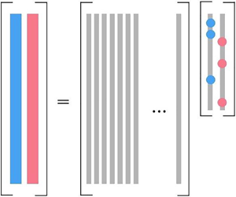
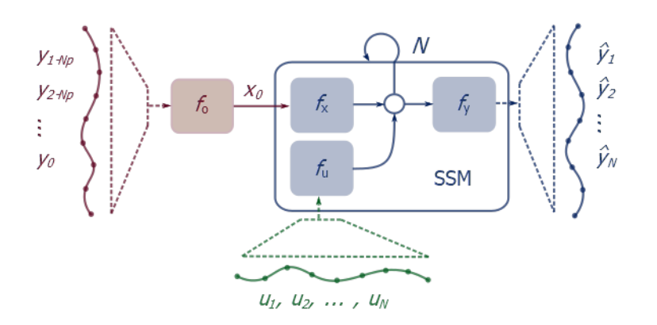
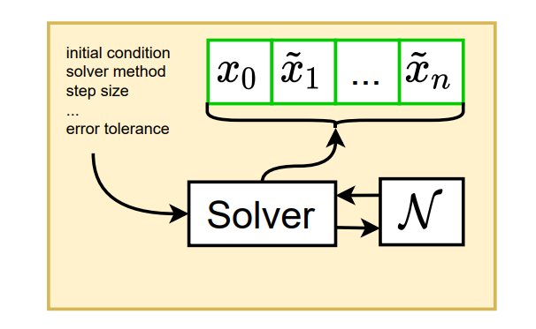
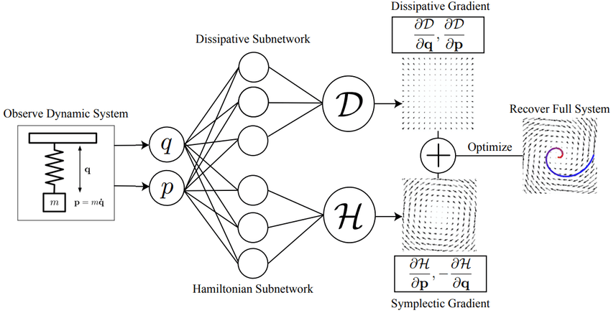
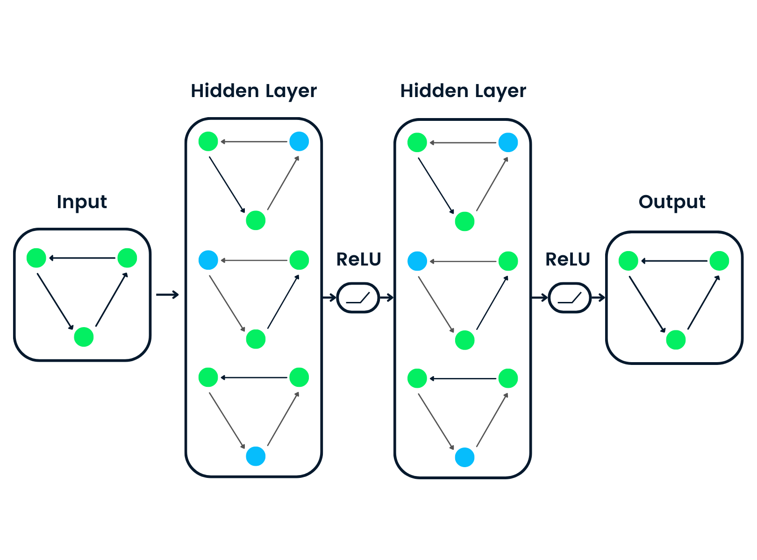
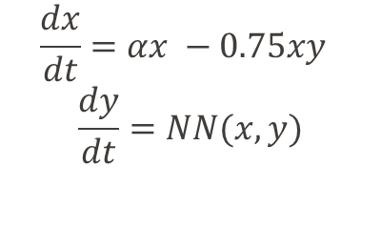
Physics-Informed Architecture Design
Sparse identification of nonlinear dynamics (SYNDy) Brunton et al., 2016
Neural State Space Models (NSSM) Skomski et al., 2021
Graph Neural Networks (GNN) Scarselli et al., 2004
Neural Ordinary Differential Equations (NODE) RTQ Chen et al., 2018
Universal Differential Equations (UDE) Rackauckas et al., 2020
Hamiltonian Neural Networks (HNN) Greydanus et al., 2019
SYNDy
NSSM
NODE
$$\frac{dx}{dt}=αx −0.75xy$$
$$\frac{dy}{dt}=NN(x,y)$$
GNN
HNN
UDE
https://github.com/pnnl/neuromancer/tree/master/examples/ODEs

Slide 11
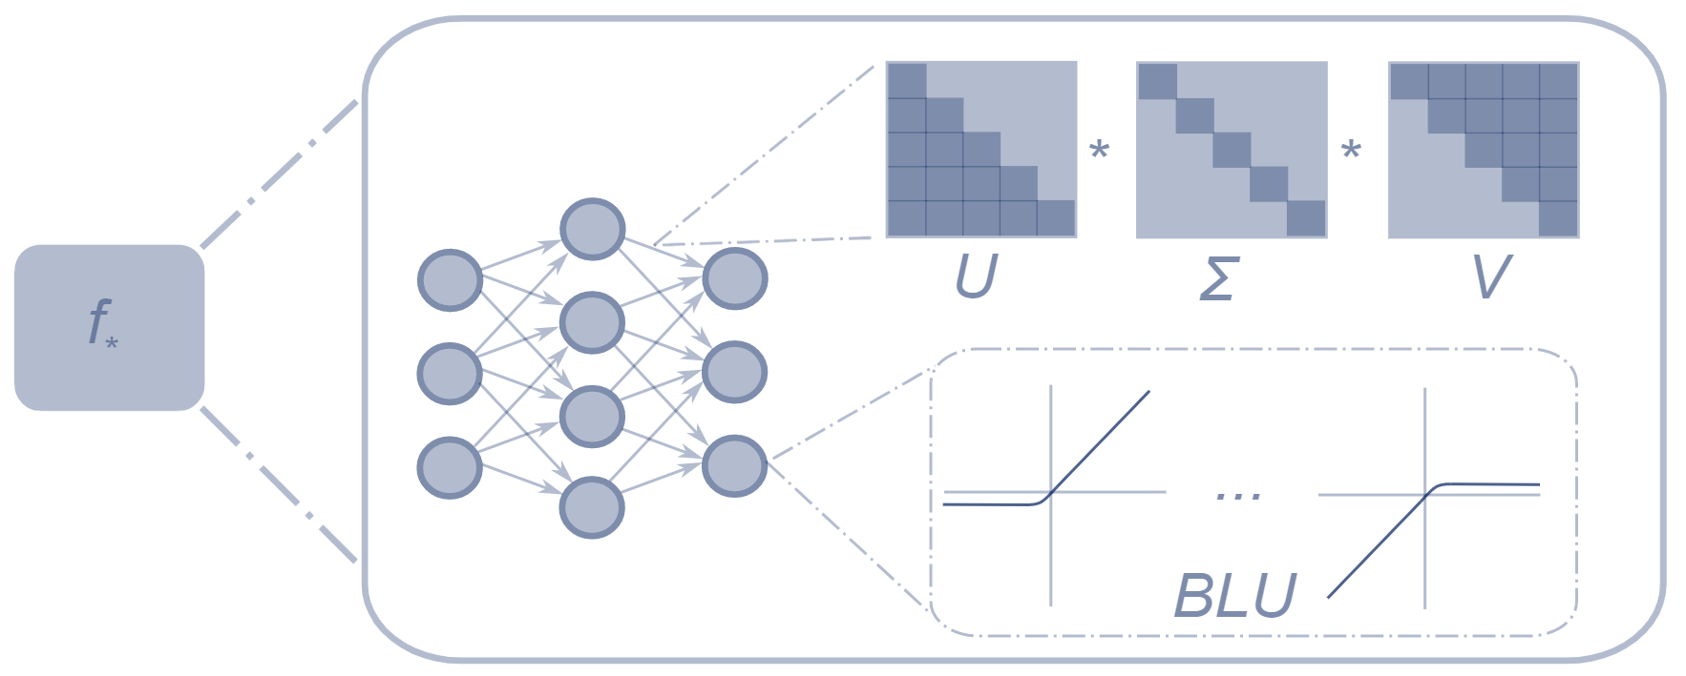
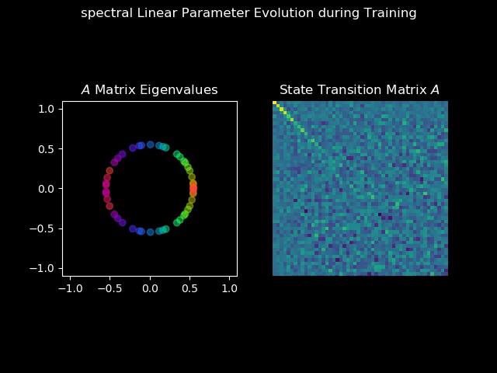
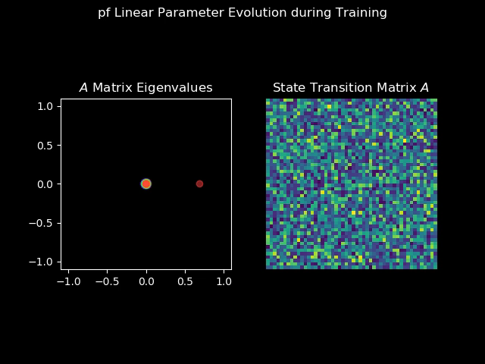
Physics-Informed Initializations and Matrix Factorizations
Can be used to enforce sparsity, spectral conditions, or other linear algebra properties:
Perron-Frobenius Tuor et al., 2020
SVD Spectral Zhang et al., 2018
Orthogonal Mhammedi et al., 2017
Symplectic Haber et al., 2017
Anti-symmetric Chang et al., 2019
Schur Decomposition Kerg et al., 2019
SVD weights
Perron-Frobenius weights
https://github.com/pnnl/neuromancer/tree/master/src/neuromancer/slim

Slide 12
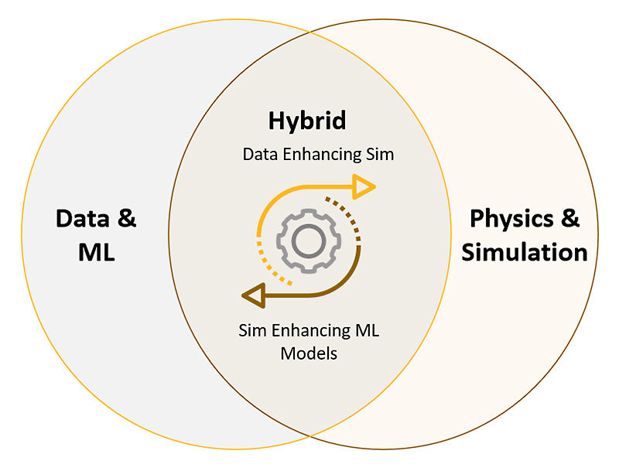
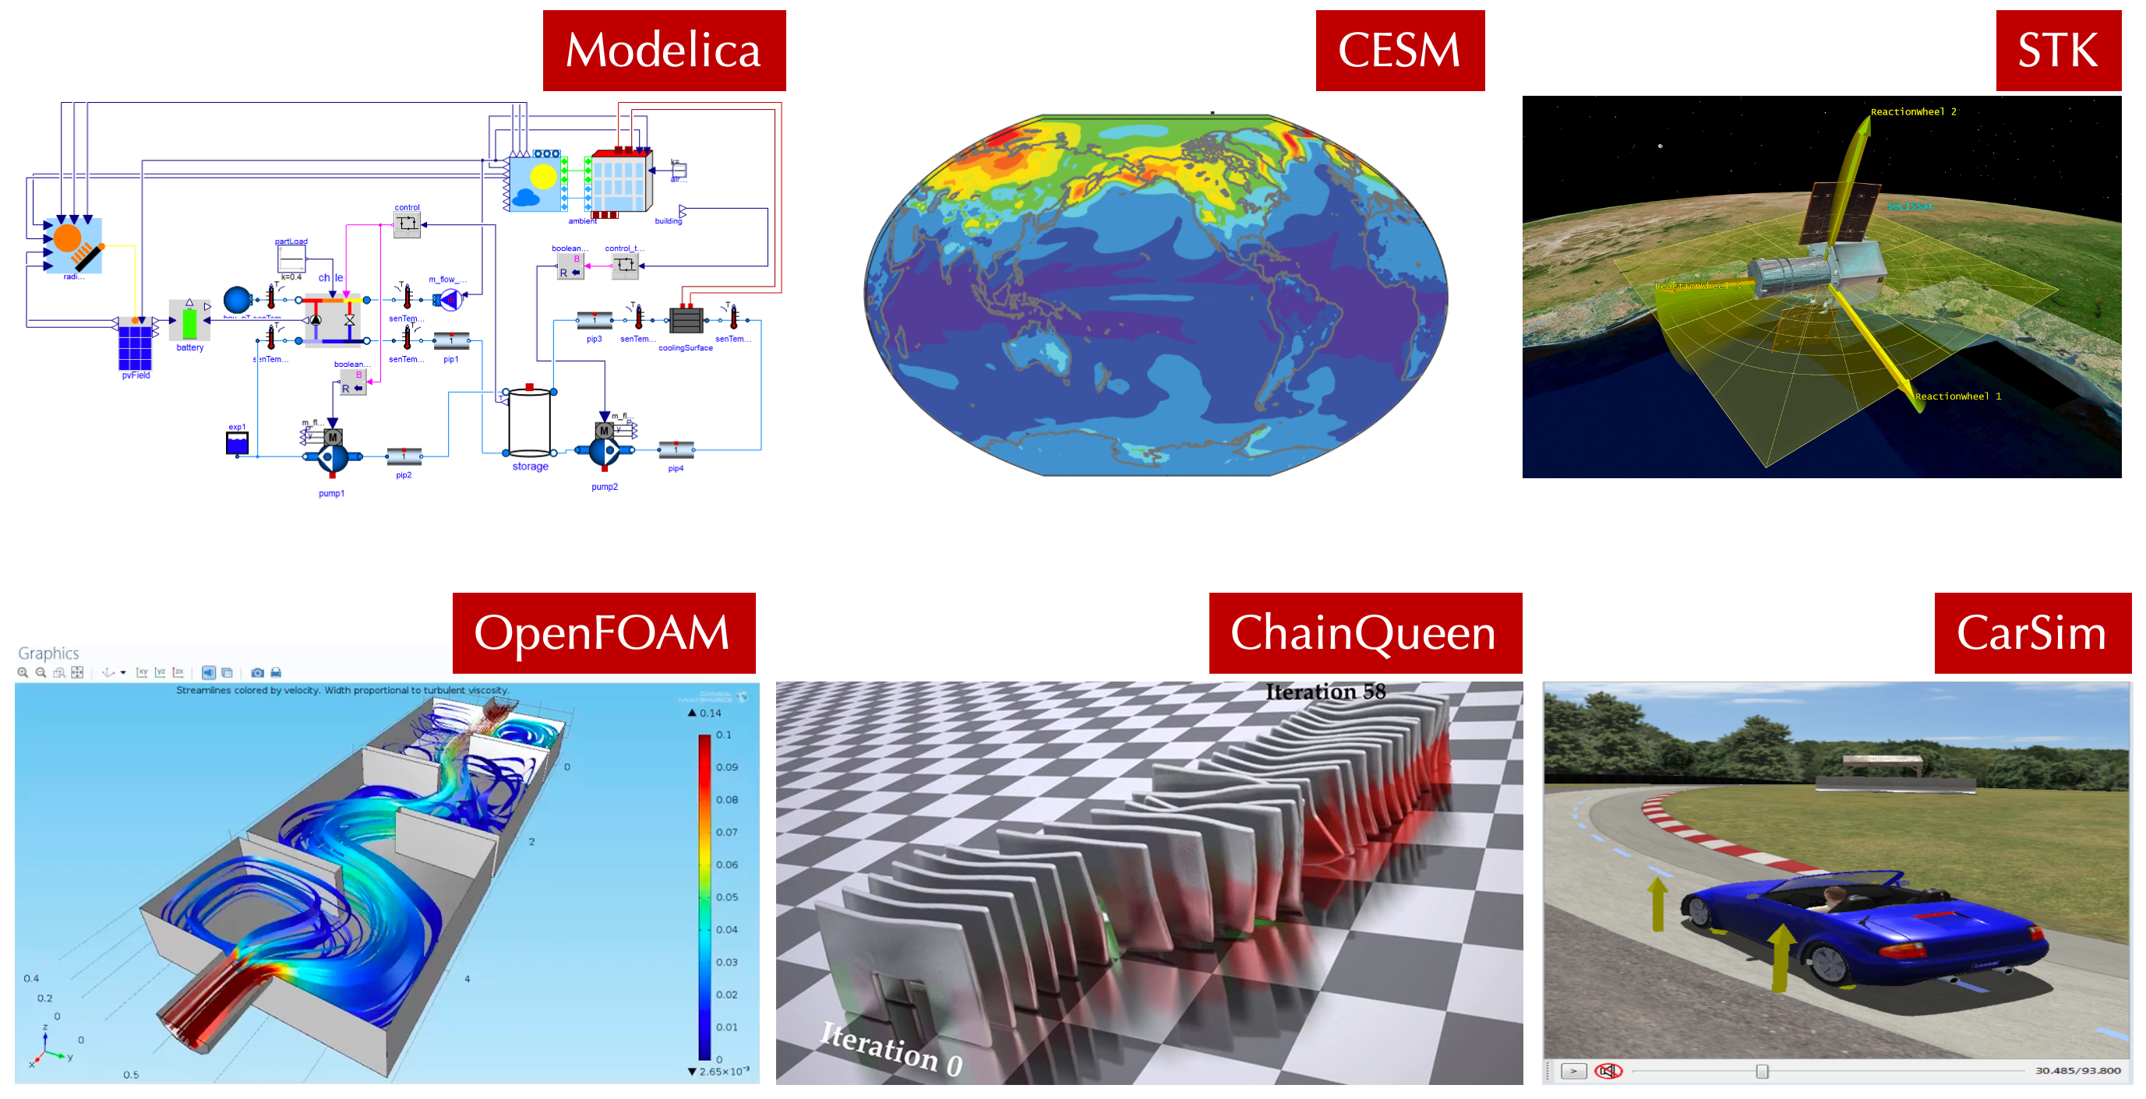

Hybrid physics-ML models
Digital twins are becoming widely available across many different domains
Physics-based modeling toolkits and simulation environments containing learning modules capable of adapting to operational data to maintain high prediction accuracy over product lifetime.
Data
Adaptation
https://www.ansys.com/blog/hybrid-analytics-tool-set-for-digital-twins
https://resources.nvidia.com/en-us-modulus-pathfactory/physics-ml-platform
[4] Nghiem T. Drgona J., et al. Physics-Informed Machine Learning for Modeling and Control of Dynamical Systems, ACC, 2023.

Slide 13



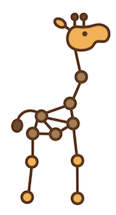

Open-source SciML Toolkit
Julia SciML: Open-Source Software for Scientific Machine Learning https://sciml.ai/
Neuromancer - PyTorch library for physics-informed system identification and control https://github.com/pnnl/neuromancer
Torchdyn - PyTorch library for neural differential equations
https://github.com/DiffEqML/torchdyn
Jraph - JAX library for graph neural networks https://github.com/deepmind/jraph
Pytorch Geometric - PyTorch library for graph neural networks
https://github.com/pyg-team/pytorch_geometric
PySINDy is a sparse regression package for the SINDy method https://github.com/dynamicslab/pysindy

Slide 14
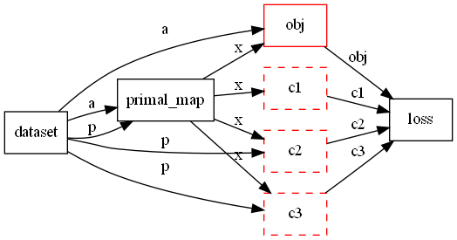
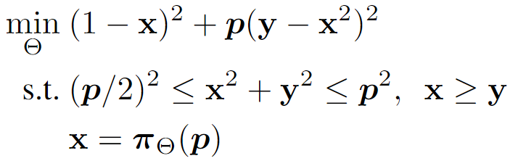
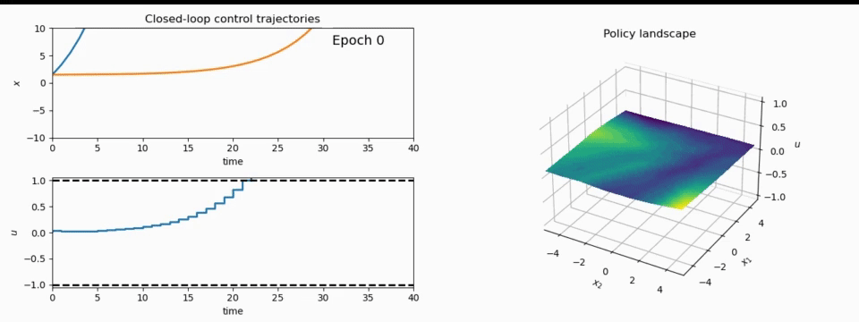
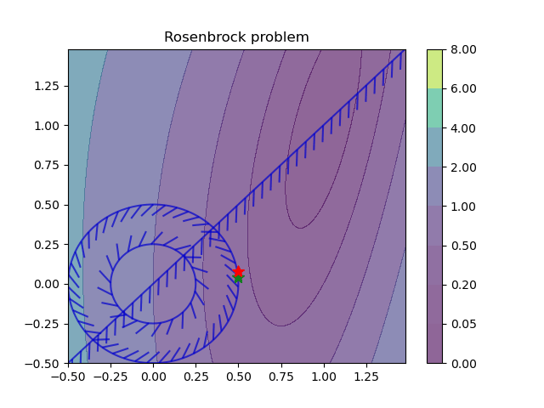
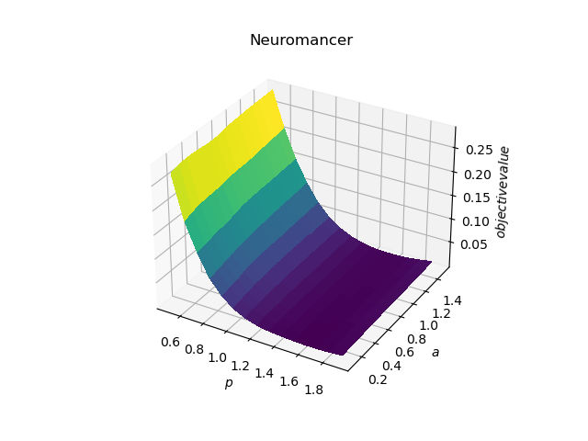
NeuroMANCER: a Scientific Machine Learning Library
1. Mathematical formulation
3. Problem graph
map
2. Python code interface
4. Results
import neuromancer as nm
p = nm.variable(‘p’)
x = nm.variable(‘x’)
y = nm.variable('y’)
obj = ((1-x)**2 + p*(y-x**2)**2).minimize(weight=1.0, name='obj’) c1 = (p/2)**2 <= x**2 + y**2
c2 = x**2 + y**2 <= p**2
c3 = x >= y net = nm.MLP(insize=2, outsize=2, hsizes=[80]*4) map = nm.Node(net, input_keys=['p’], output_keys=[‘x’,‘y’])
loss = nm.PenaltyLoss([obj], [c1, c2, c3]) problem = nm.Problem([map], loss)
optimizer = torch.optim.AdamW(problem.parameters()) trainer = nm.Trainer(problem,data,optimizer)
best_model = trainer.train()

Slide 15
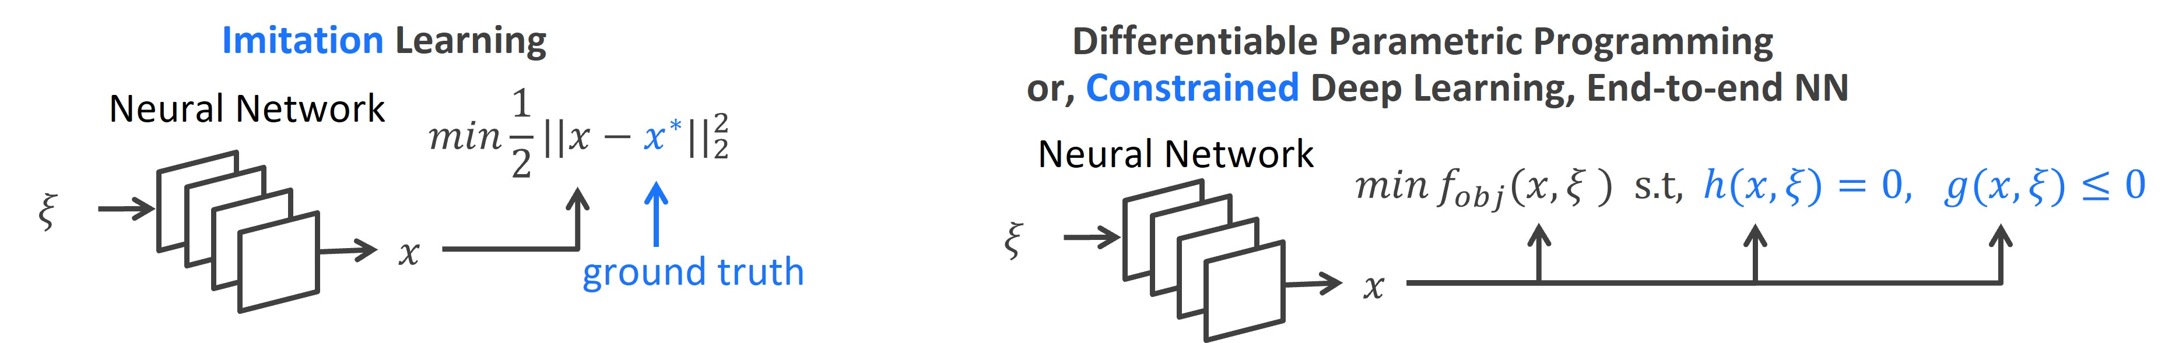
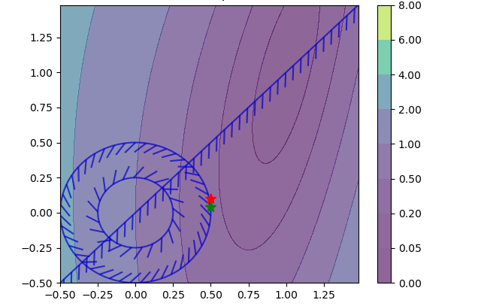
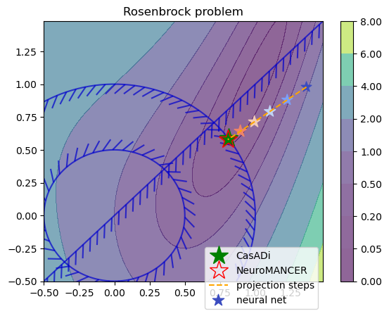
Learning to Optimize Capabilities in Neuromancer
Training neural networks as explicit solutions
Feasibility restoration with implicit layers

Slide 16
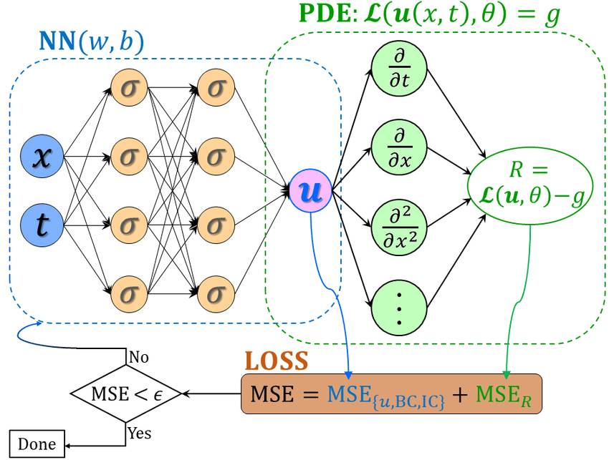
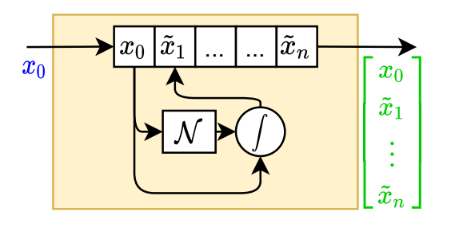
Data-driven Modeling Capabilities in Neuromancer
Component-based Physics-informed Machine Learning
Physics-Informed Neural Networks
Networked Dynamical systems
Neural differential equations

Slide 17
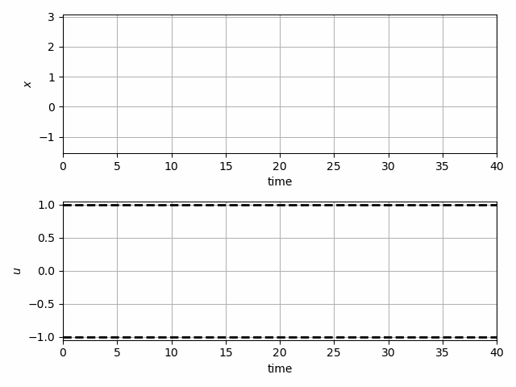
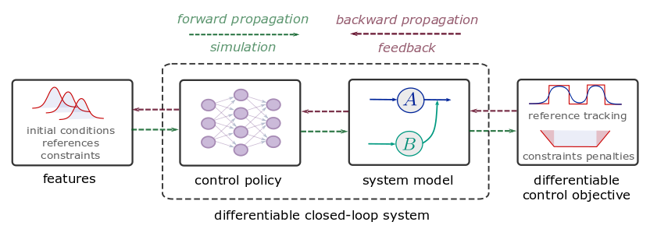
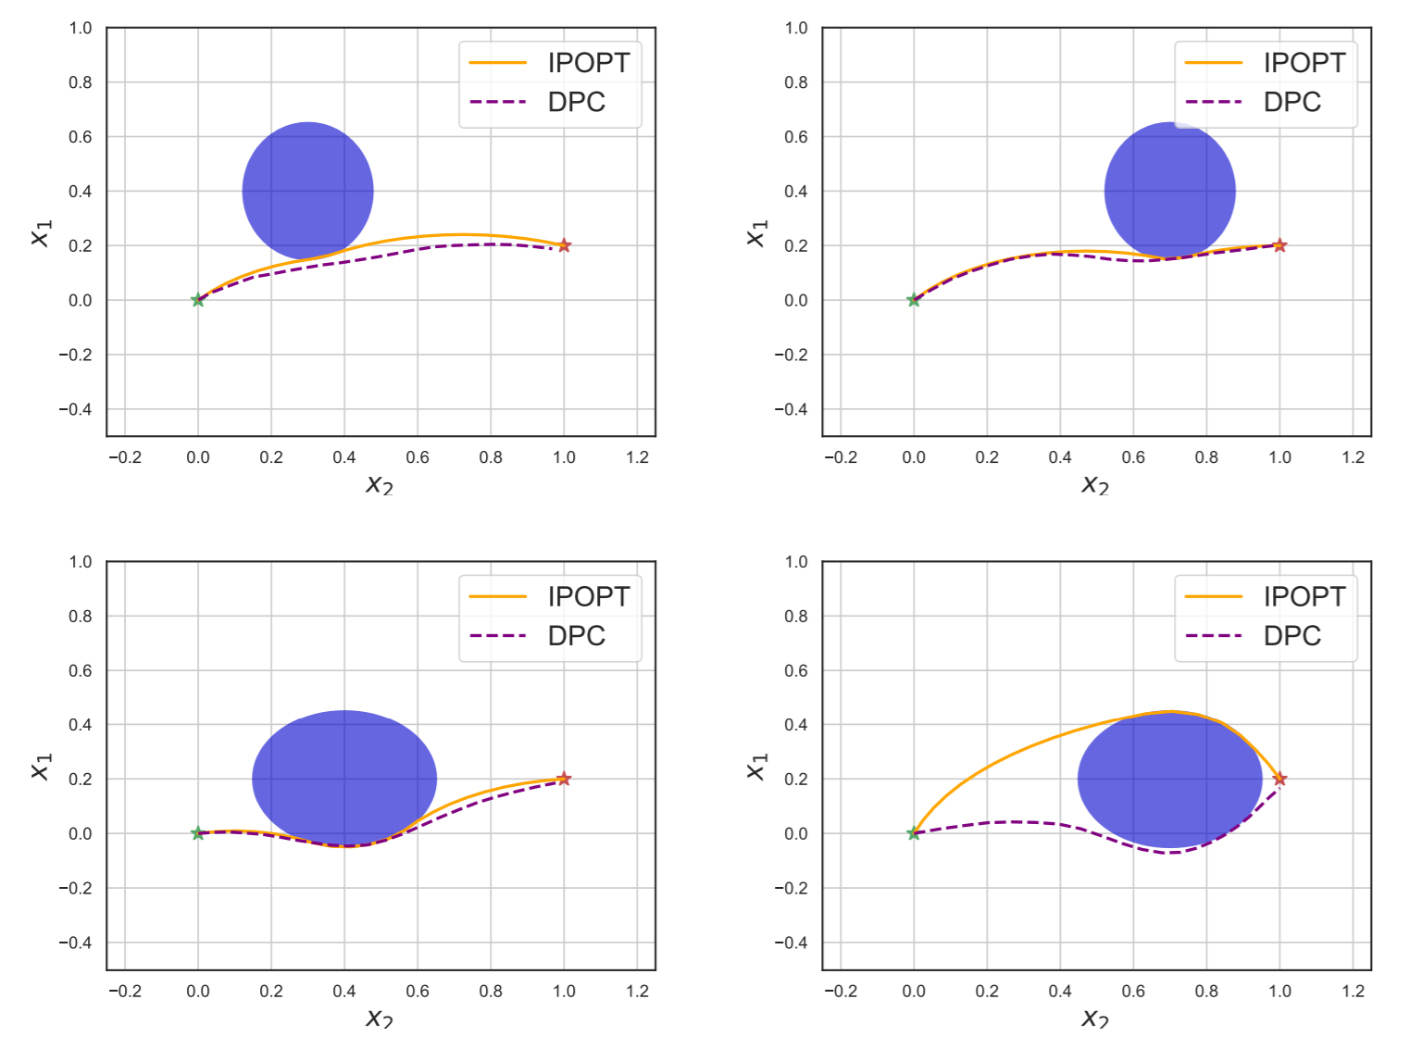
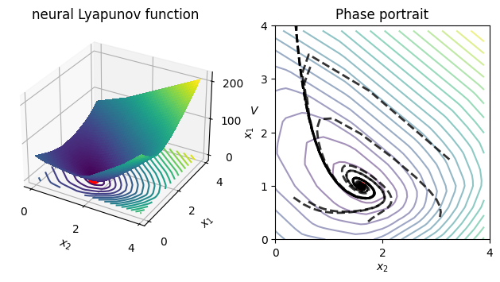
Optimal Control Capabilities in Neuromancer
Learning constrained model-based control policies with differentiable control methods
Learning stabilizing controllers
Trajectory optimization and obstacle avoidance
Learning Neural Lyapunov Functions

Slide 18



NeuroMANCER
Open-source scientific machine learning (SciML) toolbox in PyTorch for integrating deep learning, constrained optimization, and physics-based modeling
Physics-informed machine learning
Data-driven modeling of dynamical systems
Model-based policy optimization
Parametric constrained optimization
github.com/pnnl/neuromancer

Slide 19
SciML Selected Literature
Differentiable Programming
M. Innes, et al., A Differentiable Programming System to Bridge Machine Learning and Scientific Computing, 2019
Physics-informed Neural Networks
M. Raissi, et al., Physics-informed neural networks: A deep learning framework for solving forward and inverse problems involving nonlinear partial differential equations, 2019
Neural Differential Equations
R. T. Q. Chen, et al., Neural Ordinary Differential Equations, 2019
C. Rackauckas , et al., Universal Differential Equations for Scientific Machine Learning, 2021
Differentiable Optimization
A. Agrawal, et al., Differentiable Convex Optimization Layers, 2019
P. Donti, et al., DC3: A learning method for optimization with hard constraints, 2021
S. Gould, et al., Deep Declarative Networks: A New Hope, 2020
J. Kotary, et al., End-to-End Constrained Optimization Learning: A Survey, 2021
Differentiable Control
B. Amos, et al., Differentiable MPC for End-to-end Planning and Control, 2019
S. East, et al., Infinite-Horizon Differentiable Model Predictive Control, 2020

Slide 20


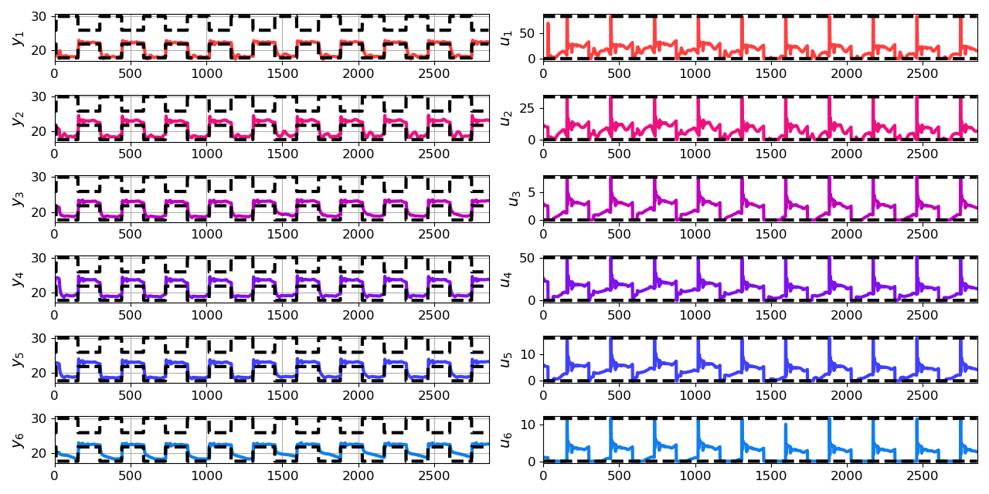
Economic Differentiable Predictive Control of Building Energy System
Architectures
Neural state space dynamics model
MLP control policy architecture
Results
Multi-input multi-output system dynamics
Dynamic economic control objective
Parametric constraints
Jan Drgona, Aaron Tuor, Elliott Skomski, Soumya Vasisht, Draguna Vrabie, Deep Learning Explicit Differentiable Predictive Control Laws for Buildings, IFAC NMPC 2021

Slide 21


Dynamics-Aware Economic Redispatch via Differentiable Predictive Control
Problem: Current redispatch processes do not incorporate system dynamics concerns. Incorporating dynamics in redispatch is too complex and/or time-consuming
Architectures
Koopman dynamics model
CNN control policy
Solution: Machine-learning based dynamics-aware redispatch. Learn system dynamics and control policies for faster assessment.
Results
5 orders of magnitude speed-up
Near optimal performance
Ethan King, Ján Drgoňa, Aaron Tuor, Shrirang Abhyankar, Craig Bakker, Arnab Bhattacharya, Draguna Vrabie, Koopman-based Differentiable Predictive Control for the Dynamics-Aware Economic Dispatch Problem, 2022 American Control Conference

Slide 22
Edge Deployment of Differentiable Predictive Control
Flexy-Air system sketch with Raspberry-Pi controller
Proof of concept for AI on the edge platform.
Jan Drgona, Karol Kis, Aaron Tuor, Draguna Vrabie, Martin Klauco, Differentiable Predictive Control: An MPC Alternative for Unknown Nonlinear Systems using Constrained Deep Learning; Journal of Process Control, 2022

Slide 23

Parametric Optimization via Differentiable Programming
Problem formulation:

Slide 24
Parametric Optimization via Differentiable Programming
Objective function
Problem formulation:
Constraints
Primal optimizers
Scenarios
Solution map
Parameters

Slide 25

Parametric Optimization via Differentiable Programming
Objective function
Problem formulation:
Constraints
Primal optimizers
Scenarios
Solution map
Parameters
Lagrangian form:
Constraints penalties
Gradient-based optimization based on AD

